Slide 1

Vs
MDM

Slide 2




Ash
Ward
Barney Lawrence

Slide 3
Plot Synopsis
The scene is set
Enter the reigning heavyweight champ
Introducing plucky young contender
Conflict ensues
A grudging respect forms
The inevitable final act team up

Slide 4
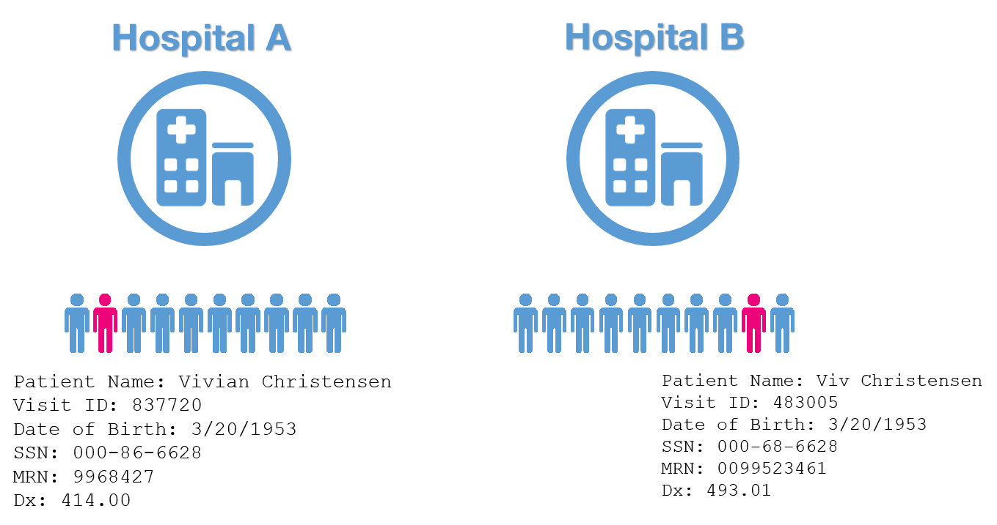
What is Record Linkage?
Joining unrelated datasets.
A problem where there isn’t a common ID between data sources.
Reporting on:
‘single view of the customer’
‘single view of the citizen’
‘single view of the child’ …across multiple data sources.
Creation of the ‘Golden Record’.

Slide 5
MDM

Slide 6
What is MDM?
CustomerName
customer
Master Data is data held by a business about its critical business entities, e.g., customers, products, suppliers.
Master Data Management (MDM) is the process of creating high-quality master data.
It serves as a trusted view of business entities that can be shared, promoting accurate reporting and analysis.
customer_name
MDM
Customer Name

Slide 7
MDM Activities & solutions
MDM involves many activities.
MDM solutions bundle many data mastering activities into a single software package.
MDM solutions enable non-technical business users (Data Stewards) to define and manage MDM operations in a friendly UI. (E.g., matching rules, confidence thresholds)
MDM Activities
Collect
Match
De-dupe
Transform
QA
Distribute

Slide 8
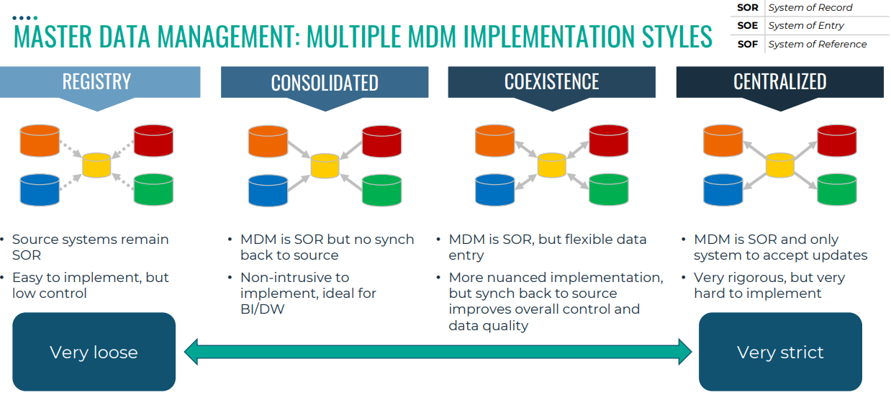
Notes:
Registry: identification of the golden record,
Consolidated: further manipulation of the golden record within MDM

Slide 9
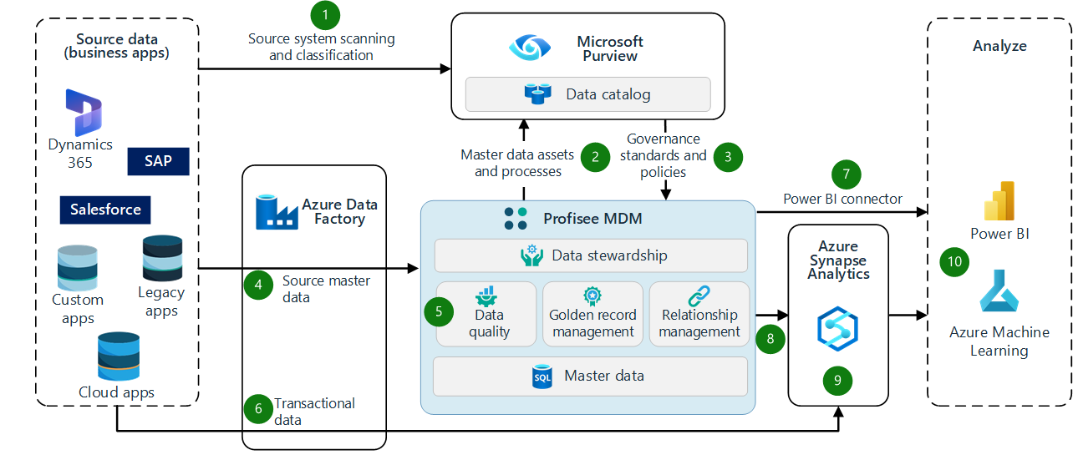
MDM Implementation
MDM

Slide 10
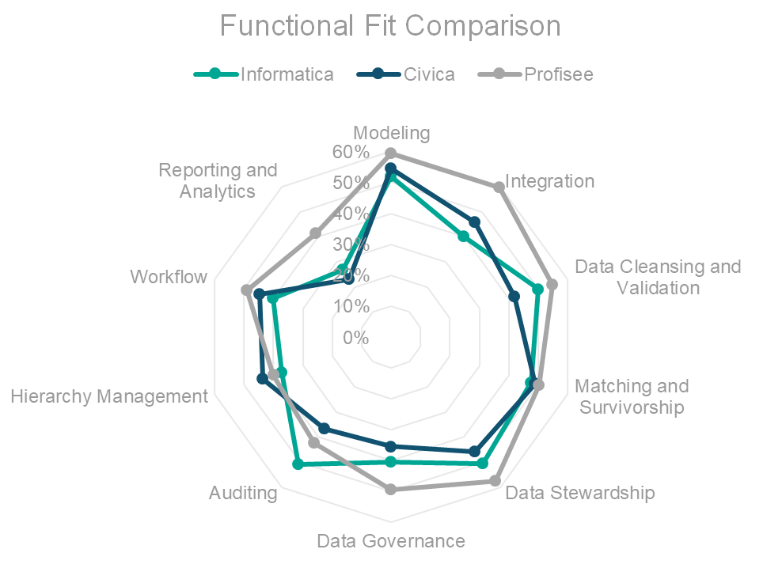
MDM Options
Fully-featured MDM
Informatica, Civica, Profisee, CluedIn, Boomi…
£75k–150k /year
‘MDM-lite’
Dynamics 365 Customer Insights
Some data mastering (matching)
£17k /year (for up to 100k records)

Slide 11
MDM Summary
Pros
Supports all MDM activities (matching, transform, QA, etc.)
Non-technical GUI
Cons
Data matching has limited flexibility (usually: match rules with fuzzy matching)
Expensive

Slide 13

Be fast enough to link upwards of 100 million records
Have a transparent methodology that can be explained by the team, and understood by users
Be as high accuracy as possible given data quality
Be flexible enough to accommodate a wider variety of input data and link multiple data sets together
Notes:
From the data linking team at the ministry of justice

Slide 14
DuckDB
Spark (Databricks and Synapse included)
Amazon Athena
SQLite
PostgreSql
Notes:
From the data linking team at the ministry of justice

Slide 15

Deterministic Matching
Barney = Barney

Slide 16

Fuzzy
Matching
B | A | R | N | E | Y
B | A | R | N | E |  |  | 1
B | A | R | N | I | E |  | 2

Slide 17


Probabilistic Matching

Slide 18

System A
System B
≠

Slide 19

System A
System B
=

Slide 20
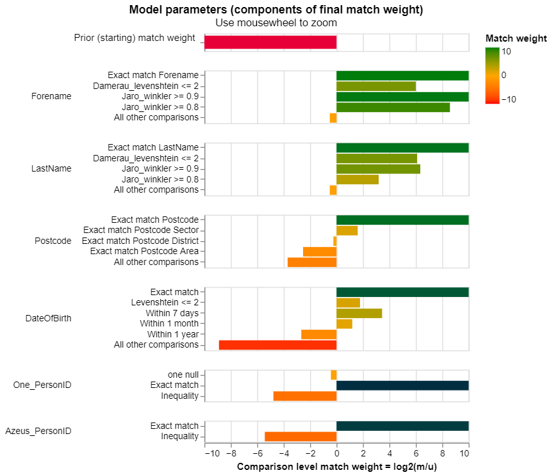

Slide 21
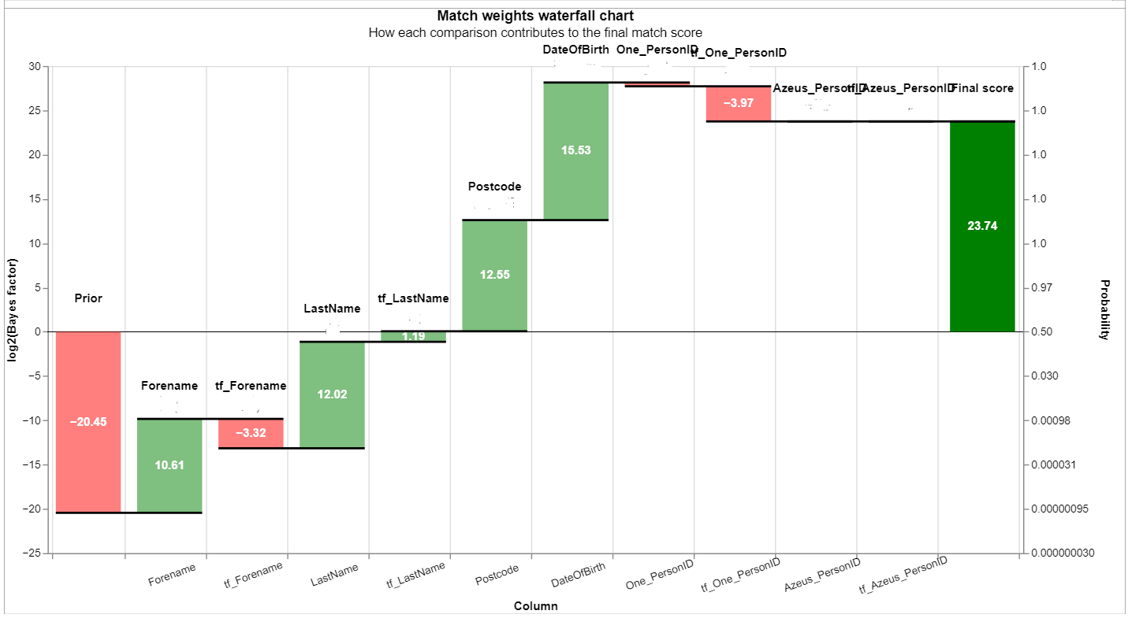

Slide 22
1,000,000 x 1,000,000
1,000,000,000,000

Slide 23

Blocking
"blocking_rules_to_generate_predictions": [
brl.exact_match_rule("LastName"),
brl.exact_match_rule("Forename"),
brl.exact_match_rule("Postcode"),
brl.exact_match_rule("DateOfBirth")
]

Slide 24
Splink Summary
Pro
Cheap
Fast
Powerful
Con
Requires technical skill
Lacks a user-friendly front end
Notes:
From the data linking team at the ministry of justice

Slide 25
MDM
Pro
Cheap
Fast
Powerful
Con
Requires technical skill
Lacks a user-friendly front end
Pro
Supports all MDM activities (matching, transform, QA, etc.)
Non-technical GUI
Con
Data matching has limited flexibility (usually: match rules with fuzzy matching)
Expensive

Slide 26


MDM

Slide 27

Thanks
Ash Ward
Barney Lawrence
Feedback

